Slide 1
HAI Smoke Testing
Kevin Kaminski

Slide 2
Agenda
Objective
Testing Theory
Process of testing samples
Preliminary results
Considerations moving forward

Slide 3
Objective
How to reduce smoke evolved from products?
  Current methods mostly subjective, eye test
  Quantify smoke evolved from core-making / metal pour
Provide R&D direction for reduced smoke products

Slide 4
Theory / Design
Airflow
Optic Sensor
Collection Chamber
Hot Plate
Pump
LED

Slide 5
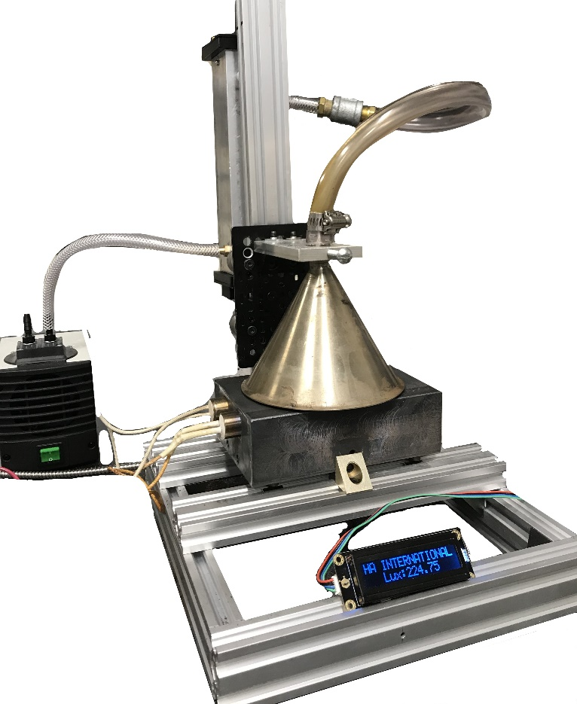
Theory / Design
Collection Chamber
Vacuum Pump
Hot plate (Up to 500°C)
LCD Readout

Slide 6
Testing Process Parameters
Sample process (Core-making)
  35g RCS sample at target temperature
  Constant -PSI
  Hot plate – 260°C (500°F)
  Immediate cycling on addition
  ~15 minute duration

Slide 7
Testing
See smoke vid.

Slide 8
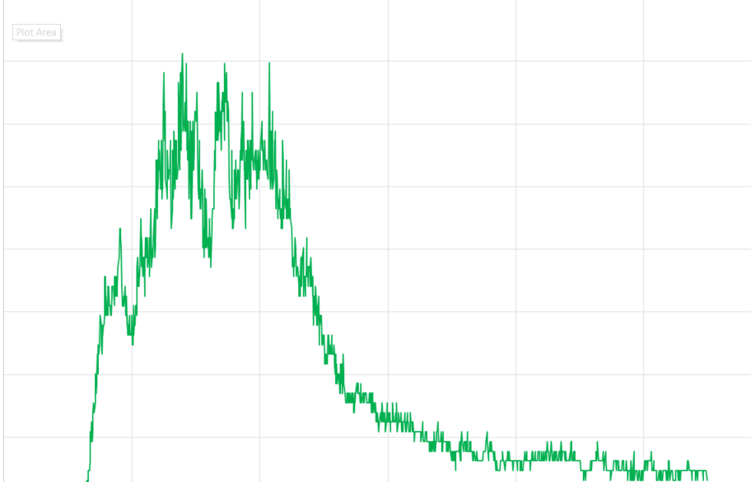
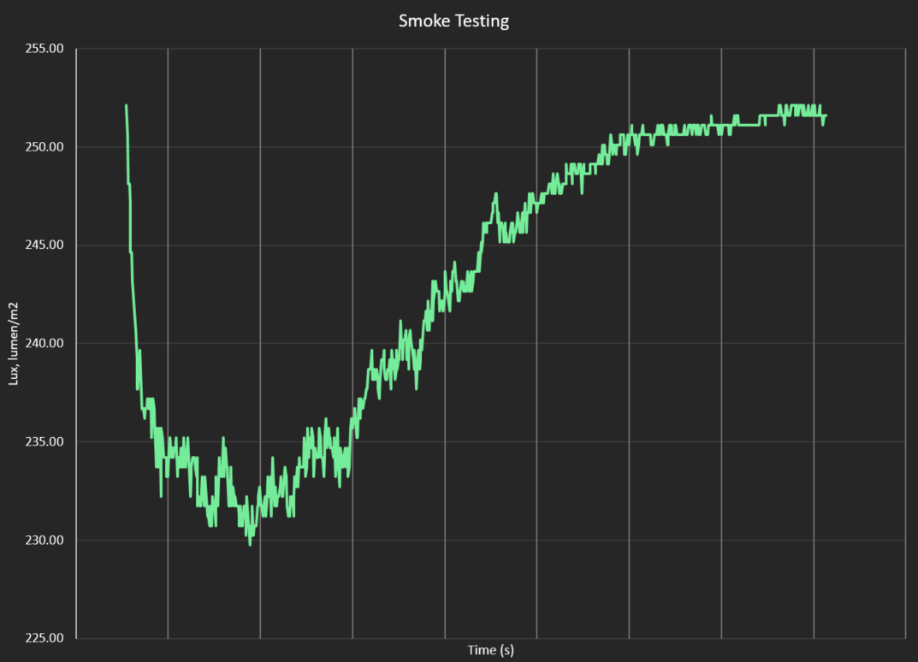
Data conversion
Measure of smoke (1-Ratio)
Measure of observed light (lux)

Slide 9
Custom Coat Eagle 70-5.4B – F-98
AUC
#F98 1-28-20 :
AVG :16.09
SD : 1.92
(14.17-18.01)
#70198 :
AVG : 13.84
SD : 2.65
(11.19-16.49)
P = 0.069

Slide 10
Steps moving forwards
Addresses metal pour vs. core-making
  Cured dog bones / HD bars
Improvement in standardization
  Sample weights, light level, vacuum, smoke concentration
Collect large data volumes to statistically compare sample
Assess contributions of individual ingredients
  Resin X v. Resin Y, Virgin v. Silica, Wax v. No Wax

Slide 11
Questions / Comments / Ideas / Insights?

